Slide 1

Transport Layer Part 4
Mark Allman
mallman@case.edu
EECS 325/425
Fall 2018
“Got my 45 on …
…so I …
… can rock on”

Slide 2
These slides are more-or-less directly from the slide set developed by Jim Kurose and Keith Ross for their book “Computer Networking: A Top Down Approach, 5th edition”.
The slides have been lightly adapted for Mark Allman’s EECS 325/425 Computer Networks class at Case Western Reserve University.
All material copyright 1996-2010
J.F Kurose and K.W. Ross, All Rights Reserved
Allman

Slide 3
Traffic By Protocol
CCZ, Sept. 10 2018
3
Allman

Slide 4
Traffic By Protocol
CCZ, Sept. 10 2018
3
Allman

Slide 5
Traffic By Protocol
TCP
UDP
CCZ, Sept. 10 2018
3
Allman

Slide 6
Traffic By Protocol
Bytes
856.2 GB
~89%
TCP
102.8 GB
~11%
UDP
CCZ, Sept. 10 2018
3
Allman

Slide 7
Traffic By Protocol
Bytes Connections
856.2 GB
~89%
1.7 M
~53%
TCP
102.8 GB
~11%
1.5 M
~47%
UDP
CCZ, Sept. 10 2018
3
Allman

Slide 8

Reading Along ...
3.5: Connection- oriented transport:TCP
Allman
4

Slide 9
TCP: Overview

Slide 10
TCP: Overview
 point-to-point:
 one sender, one receiver

Slide 11
TCP: Overview
point-to-point:
one sender, one receiver
reliable, in-order byte stream:
no “message boundaries”

Slide 12
TCP: Overview
point-to-point:
one sender, one receiver
reliable, in-order byte stream:
no “message boundaries”
pipelined:
TCP congestion and flow control set window size

Slide 13


TCP: Overview
point-to-point:
one sender, one receiver
reliable, in-order byte stream:
no “message boundaries”
pipelined:
TCP congestion and flow control set window size
send & receive buffers

Slide 14
TCP: Overview
point-to-point:
one sender, one receiver
reliable, in-order byte stream:
no “message boundaries”
pipelined:
TCP congestion and flow control set window size
send & receive buffers
full duplex data:
 bi-directional data flow in same connection

Slide 15
TCP: Overview
point-to-point:
one sender, one receiver
reliable, in-order byte stream:
no “message boundaries”
pipelined:
TCP congestion and flow control set window size
send & receive buffers
full duplex data:
 bi-directional data flow in same connection
 connection-oriented:
 handshaking inits sender, receiver state before data exchange

Slide 16
TCP: Overview
point-to-point:
one sender, one receiver
reliable, in-order byte stream:
no “message boundaries”
pipelined:
TCP congestion and flow control set window size
send & receive buffers
full duplex data:
 bi-directional data flow in same connection
connection-oriented:
handshaking inits sender, receiver state before data exchange
congestion controlled:
won’t overwhelm network
(tackle later in semester)

Slide 17
TCP: Overview
point-to-point:
one sender, one receiver
reliable, in-order byte stream:
no “message boundaries”
pipelined:
TCP congestion and flow control set window size
send & receive buffers
full duplex data:
 bi-directional data flow in same connection
connection-oriented:
handshaking inits sender, receiver state before data exchange
congestion controlled:
won’t overwhelm network
 (tackle later in semester)
flow controlled:
 won’t overwhelm receiver
Transport Layer

Slide 18
TCP: Overview
RFCs: 793, 1122, 1323, 2018, 2883,
3042, 3390, 5681, 6298, 6675, etc
point-to-point:
one sender, one receiver
reliable, in-order byte stream:
no “message boundaries”
pipelined:
TCP congestion and flow control set window size
send & receive buffers
full duplex data:
 bi-directional data flow in same connection
connection-oriented:
handshaking inits sender, receiver state before data exchange
congestion controlled:
won’t overwhelm network
 (tackle later in semester)
flow controlled:
 won’t overwhelm receiver
Transport Layer

Slide 19
Reading Along ...
3.5: Connection- oriented transport:TCP
segment structure
Allman
6

Slide 20
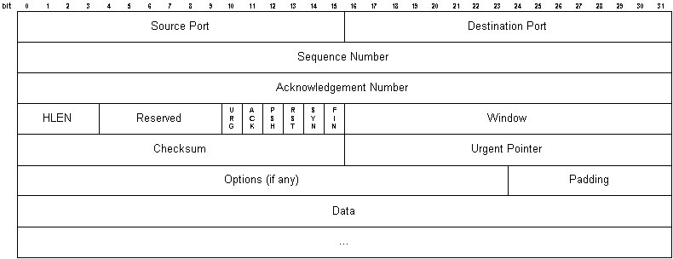
TCP Segment Structure

Slide 21
TCP Segment Structure

Slide 22
TCP Segment Structure

Slide 23
TCP Segment Structure

Slide 24
TCP Segment Structure

Slide 25
TCP Segment Structure

Slide 26
TCP Segment Structure

Slide 27
TCP Segment Structure

Slide 28
TCP Segment Structure

Slide 29
TCP Segment Structure

Slide 30
TCP Segment Structure

Slide 31
TCP Segment Structure

Slide 32
TCP Segment Structure

Slide 33
TCP Segment Structure

Slide 34
TCP Segment Structure

Slide 35
TCP Segment Structure

Slide 36
TCP Segment Structure

Slide 37
TCP seq. #’s and ACKs

Slide 38
TCP seq. #’s and ACKs
Seq. #’s:
 byte stream “number” of first byte in segment’s data

Slide 39
TCP seq. #’s and ACKs
Seq. #’s:
byte stream “number” of first byte in segment’s data
ACKs:
seq # of next byte expected from other side
cumulative ACK

Slide 40
TCP seq. #’s and ACKs
Seq. #’s:
byte stream “number” of first byte in segment’s data
ACKs:
seq # of next byte expected from other side
cumulative ACK
Q: how receiver handles out- of-order segments

Slide 41
TCP seq. #’s and ACKs
Seq. #’s:
byte stream “number” of first byte in segment’s data
ACKs:
seq # of next byte expected from other side
cumulative ACK
Q: how receiver handles out- of-order segments
A: TCP spec doesn’t say, - up to implementor

Slide 42


TCP seq. #’s and ACKs
Seq. #’s:
byte stream “number” of first byte in segment’s data
ACKs:
seq # of next byte expected from other side
cumulative ACK
Q: how receiver handles out- of-order segments
A: TCP spec doesn’t
Host A
Host B
time
say, - up to implementor
simple telnet scenario

Slide 43
TCP seq. #’s and ACKs
Seq. #’s:
byte stream “number” of first byte in segment’s data
ACKs:
seq # of next byte expected from other side
cumulative ACK
Q: how receiver handles out- of-order segments
A: TCP spec doesn’t say, - up to implementor
Host A
Host B
User types ‘C’
time
simple telnet scenario
Transport Layer
3-

Slide 44
TCP seq. #’s and ACKs
Seq. #’s:
byte stream “number” of first byte in segment’s data
ACKs:
seq # of next byte expected from other side
cumulative ACK
Q: how receiver handles out- of-order segments
A: TCP spec doesn’t say, - up to implementor
Host A
Host B
User types ‘C’
Seq=42, ACK=79, data = ‘C’
time
simple telnet scenario
Transport Layer
3-

Slide 45
TCP seq. #’s and ACKs
Seq. #’s:
byte stream “number” of first byte in segment’s data
ACKs:
seq # of next byte expected from other side
cumulative ACK
Q: how receiver handles out- of-order segments
A: TCP spec doesn’t say, - up to implementor
Host A
Host B
User types ‘C’
Seq=42, ACK=79, data = ‘C’
host ACKs receipt of ‘C’, echoes back ‘C’
time
simple telnet scenario
Transport Layer
3-

Slide 46
TCP seq. #’s and ACKs
Seq. #’s:
byte stream “number” of first byte in segment’s data
ACKs:
seq # of next byte expected from other side
cumulative ACK
Q: how receiver handles out-
Host A
Host B
User types ‘C’
Seq=42, ACK=79, data = ‘C’
host ACKs receipt of ‘C’, echoes back ‘C’
Seq=79, ACK=43, data = ‘C’
of-order segments
 A: TCP spec doesn’t say, - up to implementor
time
simple telnet scenario

Slide 47
TCP seq. #’s and ACKs
Seq. #’s:
byte stream “number” of first byte in segment’s data
ACKs:
seq # of next byte expected from other side
Host A
Host B
User types ‘C’
Seq=42, ACK=79, data = ‘C’
host ACKs receipt of ‘C’, echoes back ‘C’
Seq=79, ACK=43, data = ‘C’
host ACKs
 cumulative ACK
receipt
Q: how receiver handles out- ^{of echoed}
‘C’
of-order segments
 A: TCP spec doesn’t say, - up to implementor
time
simple telnet scenario

Slide 48
TCP seq. #’s and ACKs
Seq. #’s:
byte stream “number” of first byte in segment’s data
ACKs:
seq # of next byte expected from other side
Host A
Host B
User types ‘C’
Seq=42, ACK=79, data = ‘C’
host ACKs receipt of ‘C’, echoes back ‘C’
Seq=79, ACK=43, data = ‘C’
host ACKs
 cumulative ACK
receipt
Seq=43, ACK=80
Q: how receiver handles out- ^{of echoed}
‘C’
of-order segments
 A: TCP spec doesn’t say, - up to implementor
time
simple telnet scenario

Slide 49
Reading Along ...
3.5: Connection- oriented transport:TCP
connection management
Allman
9

Slide 50
TCP Connection Management
Recall: TCP sender, receiver establish “connection” before exchanging data segments
initialize TCP variables:
seq. #s
buffers, flow control info (e.g. RcvWindow)
etc.

Slide 51
TCP Connection Management
Recall: TCP sender, receiver establish “connection” before exchanging data segments
initialize TCP variables:
seq. #s
buffers, flow control info (e.g. RcvWindow)
etc.
Three way handshake:

Slide 52
TCP Connection Management
Recall: TCP sender, receiver establish “connection” before exchanging data segments
initialize TCP variables:
seq. #s
buffers, flow control info (e.g. RcvWindow)
etc.
Three way handshake:
Step 1: client host sends TCP SYN segment to server
specifies initial seq #
no data

Slide 53
TCP Connection Management
Recall: TCP sender, receiver establish “connection” before exchanging data segments
initialize TCP variables:
seq. #s
buffers, flow control info (e.g. RcvWindow)
etc.
Three way handshake:
Step 1: client host sends TCP SYN segment to server
specifies initial seq #
no data
Step 2: server host receives SYN, replies with SYNACK segment
server allocates buffers
specifies server initial seq. #

Slide 54
TCP Connection Management
Recall: TCP sender, receiver establish “connection” before exchanging data segments
initialize TCP variables:
seq. #s
buffers, flow control info (e.g. RcvWindow)
etc.
Three way handshake:
Step 1: client host sends TCP SYN segment to server
specifies initial seq #
no data
Step 2: server host receives SYN, replies with SYNACK segment
server allocates buffers
specifies server initial seq. # Step 3: client receives SYNACK,
replies with ACK segment, which may contain data

Slide 55
TCP Connection Management (cont.)

Slide 56
TCP Connection Management (cont.)
Closing a connection:

Slide 57
TCP Connection Management (cont.)
Closing a connection:
client closes socket:
close(sd);

Slide 58
TCP Connection Management (cont.)
Closing a connection:
client closes socket:
close(sd);
Step 1: client end system sends TCP FIN control segment to server

Slide 59
TCP Connection Management (cont.)
Closing a connection:
client closes socket:
close(sd);
Step 1: client end system sends TCP FIN control segment to server
Step 2: server receives FIN, replies with ACK. Closes connection, sends FIN.

Slide 60


TCP Connection Management (cont.)
Closing a connection:
client closes socket:
close(sd);
client
server
close
FIN
Step 1: client end system sends TCP FIN control
segment to server
Step 2: server receives FIN, replies with ACK. Closes connection, sends FIN.
ACK
close
FIN
timed wait
ACK
closed

Slide 61
TCP Connection Management (cont.)
Step 3: client receives FIN, replies with ACK.
 Enters “timed wait” - will respond with ACK to received FINs
client
server
closing
FIN
ACK
closing
FIN
timed wait
ACK
closed
closed

Slide 62
TCP Connection Management (cont.)
Step 3: client receives FIN, replies with ACK.
 Enters “timed wait” - will respond with ACK to received FINs
Step 4: server, receives ACK. Connection closed.
client
server
closing
FIN
ACK
closing
FIN
timed wait
ACK
closed
closed

Slide 63
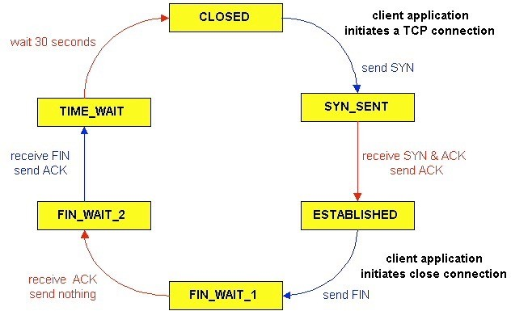
TCP Connection Management (cont)
TCP client lifecycle

Slide 64
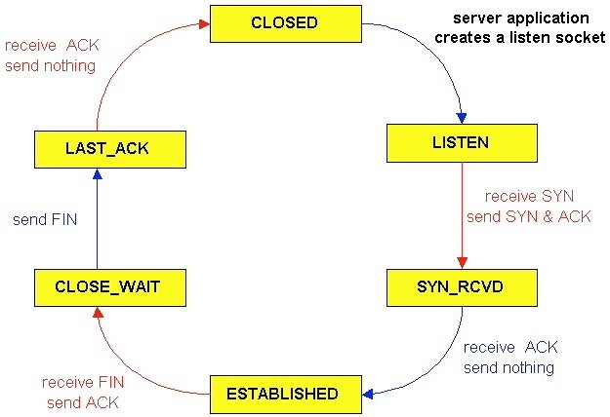
TCP Connection Management (cont)
TCP server lifecycle

Slide 65
Reading Along ...
3.5: Connection- oriented transport:TCP
timeouts
Allman
15

Slide 66
TCP Timeouts and the RTT

Slide 67
TCP Timeouts and the RTT
Q: How to set TCP timeout value?

Slide 68
TCP Timeouts and the RTT
Q: How to set TCP timeout value?
 longer than RTT …

Slide 69
TCP Timeouts and the RTT
Q: How to set TCP timeout value?
longer than RTT …
… but RTT varies

Slide 70
Measured RTTs
ping measurements from eecslab-5

Slide 71
Measured RTTs
ping measurements from eecslab-5
Remote Host RTT (msec)

Slide 72
Measured RTTs
ping measurements from eecslab-5
Remote Host
RTT (msec)
eecslab-6.case.edu
0.5

Slide 73
Measured RTTs
ping measurements from eecslab-5
Remote Host RTT (msec)
eecslab-6.case.edu www.ohiou.edu | 0.5
 | 7.9

Slide 74
Measured RTTs
ping measurements from eecslab-5
Remote Host RTT (msec)
eecslab-6.case.edu www.ohiou.edu www.icir.org | 0.5
 | 7.9
 | 71

Slide 75
Measured RTTs
ping measurements from eecslab-5
Remote Host | RTT (msec)
eecslab-6.case.edu | 0.5
www.ohiou.edu | 7.9
www.icir.org | 71
www.iij.ad.jp | 171

Slide 76
TCP Timeouts and the RTT

Slide 77
TCP Timeouts and the RTT
Q: How to set TCP timeout value?
longer than RTT …
… but RTT varies

Slide 78
TCP Timeouts and the RTT
Q: How to set TCP timeout value?
longer than RTT …
… but RTT varies
Q: What if we set the timeout too short?

Slide 79
TCP Timeouts and the RTT
Q: How to set TCP timeout value?
longer than RTT …
… but RTT varies
Q: What if we set the timeout too short?
premature timeout
unnecessary retransmissions

Slide 80
TCP Timeouts and the RTT
Q: How to set TCP timeout value?
longer than RTT …
… but RTT varies
Q: What if we set the timeout too short?
premature timeout
unnecessary retransmissions
Q: What if we set the timeout too long?

Slide 81
TCP Timeouts and the RTT
Q: How to set TCP timeout value?
longer than RTT …
… but RTT varies
Q: What if we set the timeout too short?
premature timeout
unnecessary retransmissions
Q: What if we set the timeout too long?
slow reaction to loss

Slide 82
TCP Timeouts and the RTT

Slide 83
TCP Timeouts and the RTT
Q: How do we estimate the RTT?

Slide 84
TCP Timeouts and the RTT
Q: How do we estimate the RTT?
 measure time between data transmission and ACK

Slide 85
TCP Timeouts and the RTT
Q: How do we estimate the RTT?
Measure time between data transmission and ACK
do not time retransmissions
(Karn/Partridge algorithm)

Slide 86
TCP Timeouts and the RTT
Q: How do we estimate the RTT?
Measure time between data transmission and ACK
do not time retransmissions
(Karn/Partridge algorithm)
RTT will vary across measurements

Slide 87
TCP Timeouts and the RTT
Q: How do we estimate the RTT?
Measure time between data transmission and ACK
do not time retransmissions
(Karn/Partridge algorithm)
RTT will vary across measurements
want something smoother
instead of just the current RTT, use an average of the last few measurements
the “smoothed RTT” (SRTT)

Slide 88
TCP RTO
 RFC 6298
SRTT = (1- α)*SRTT + α*R
Exponential weighted moving average
influence of past sample decreases exponentially fast
standard value: α = 0.125

Slide 89
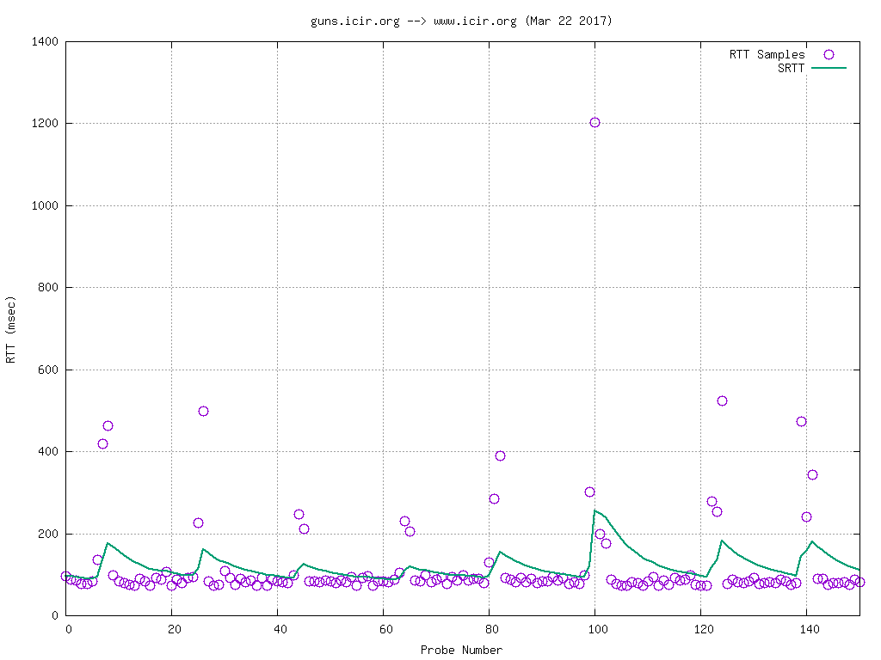
Example SRTT Computation

Slide 90
TCP RTO

Slide 91
TCP RTO
Setting the timeout
 SRTT plus “safety margin”
 large variation in SRTT -> larger safety margin

Slide 92
TCP RTO
Setting the timeout
SRTT plus “safety margin”
 large variation in SRTT -> larger safety margin
first, estimate of how much SRTT deviates from the RTT sample:

Slide 93
TCP RTO
Setting the timeout
SRTT plus “safety margin”
 large variation in SRTT -> larger safety margin
first, estimate of how much SRTT deviates from the RTT sample:
RTTVAR = (1-β)*RTTVAR + β*|R-SRTT|
(β = 0.25, per standard)

Slide 94
TCP RTO
Setting the timeout
SRTT plus “safety margin”
 large variation in SRTT -> larger safety margin
first, estimate of how much SRTT deviates from the RTT sample:
RTTVAR = (1-β)*RTTVAR + β*|R-SRTT|
(β = 0.25, per standard)
Then set timeout interval:
RTO = SRTT + 4*RTTVAR

Slide 95
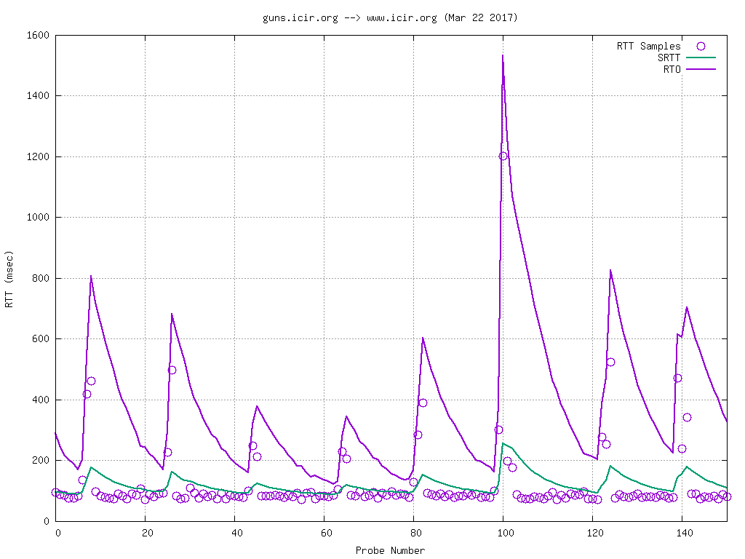
Example RTO Computation

Slide 96
TCP RTO

Slide 97
TCP RTO
But, one issue remains ...

Slide 98
TCP RTO
But, one issue remains ...
 where do we start?!

Slide 99
TCP RTO
But, one issue remains ...
where do we start?!
RFC 1122, RFC 2988 specify 3 seconds
why?

Slide 100
TCP RTO
But, one issue remains ...
where do we start?!
RFC 1122, RFC 2988 specify 3 seconds
why?
RFC 1122 published in 1989. RFC 2988
published in 2000.

Slide 101
TCP RTO
But, one issue remains ...
where do we start?!
RFC 1122, RFC 2988 specify 3 seconds
why?
RFC 1122 published in 1989. RFC 2988
published in 2000.
does this constant still apply?

Slide 102
TCP Initial RTO

Slide 103

TCP Initial RTO
Matt Sargent
Case PhD, 2015

Slide 104
TCP Initial RTO
Matt Sargent
Case PhD, 2015
Hypothesizes that an initial RTO developed in 1989 might not be appropriate anymore
Conducts an empirical investigation

Slide 105
TCP Initial RTO

Slide 106
TCP Initial RTO
How do we choose?

Slide 107
TCP Initial RTO
How do we choose?
look at some data!
investigated eight datasets (spanning 6 years)
datasets are packet traces!

Slide 108
TCP Initial RTO
How do we choose?
look at some data!
investigated eight datasets (spanning 6 years)
datasets are packet traces!
Lowering the InitRTO from 3 seconds to 1 second has cost:
.... less than 0.1% of the connections spuriously retransmit the SYN in most datasets
.... 1.1% of the connections in a wireless network spuriously retransmit the SYN

Slide 109
TCP Initial RTO

Slide 110
TCP Initial RTO
Connections experience performance boost when SYN is lost and requires retransmission
i.e., connections only wait for 1sec when previously waited 3sec

Slide 111
TCP Initial RTO
Connections experience performance boost when SYN is lost and requires retransmission
i.e., connections only wait for 1sec when previously waited 3sec
Connections realizing >= 10% boost:
10-43% (across datasets)
Connections realizing >= 50% boost:
17-73% (across datasets)

Slide 112
TCP Initial RTO
The IETF decided that Matt’s evidence was compelling
The initial RTO was lowered from 3sec to 1sec
 specified in RFC 6298
Details of Matt’s investigation are given in appendix of RFC 6298

Slide 113
TCP RTO

Slide 114
TCP RTO
One more thing ...
What if we retransmit and the resent segment is dropped?

Slide 115
TCP RTO
One more thing ...
What if we retransmit and the resent segment is dropped?
Backoff the RTO
RTO *= 2
(similar to collision backoff in Ethernet)
Part of TCP’s congestion control mechanism

Slide 116
Magic Numbers

Slide 117
Magic Numbers
Where do the constants in the RTO mechanism come from?
 e.g., alpha = 0.125
e.g., initRTO = 1sec
e.g., we multiple RTTVAR by 4

Slide 118
Magic Numbers
Where do the constants in the RTO mechanism come from?
 e.g., alpha = 0.125
e.g., initRTO = 1sec
e.g., we multiple RTTVAR by 4
Rough consensus …
but, it still stinks
We strive for mechanisms that do not require magic constants

